Slide 1
Visual Calculations
Visual calculations in PowerBI is the ability to perform data transformations and calculations within the visuals.
When working with DAX gets complex to understand in certain conditions to get the solution, Microsoft has introduced this visual calculations for better understanding and making it ease.

Slide 2
What is it?
It is a DAX calculation that’s defined and executed directly on the visual.
It is simpler, easy to maintain and it has better performance comparatively.
Visual calculations works on aggregated data instead of entire model.

Slide 3
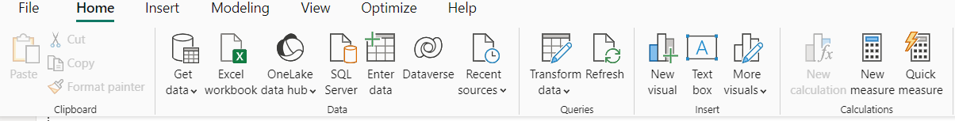
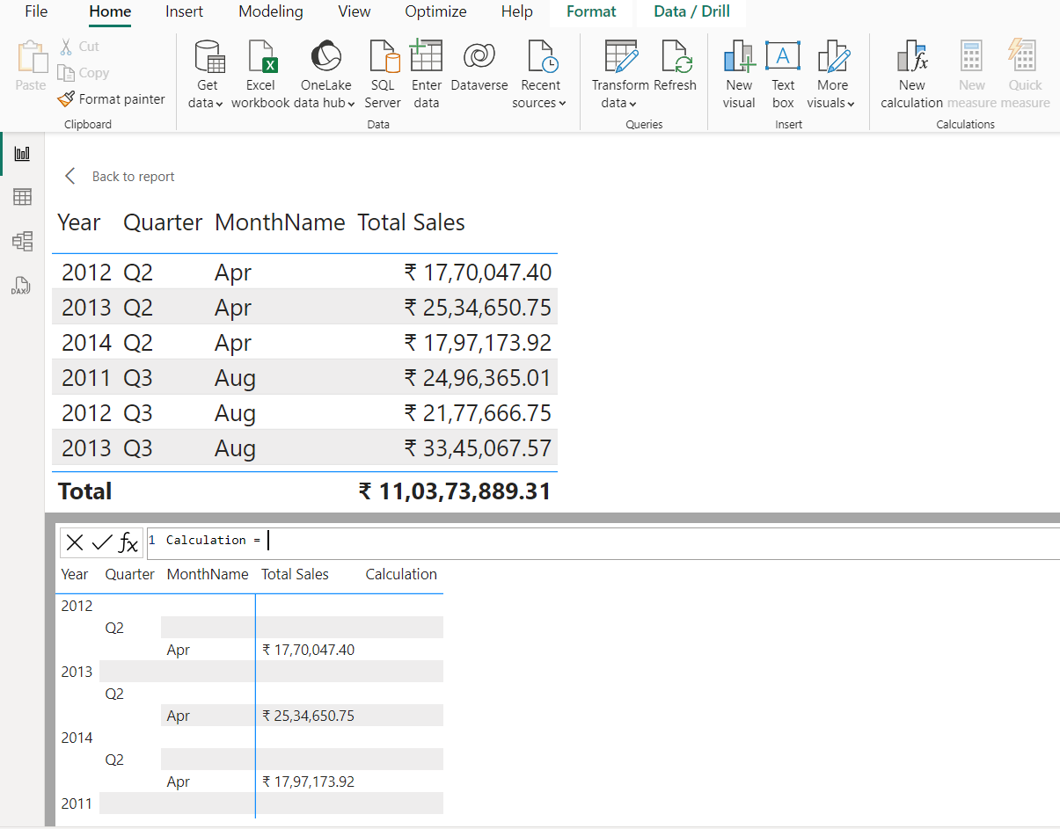

enable it from the preview features in option and settings
After enabling that feature it is visible under Home menu in the calculations part as a New Calculation.
By default it only works when we select a visual.

Slide 4
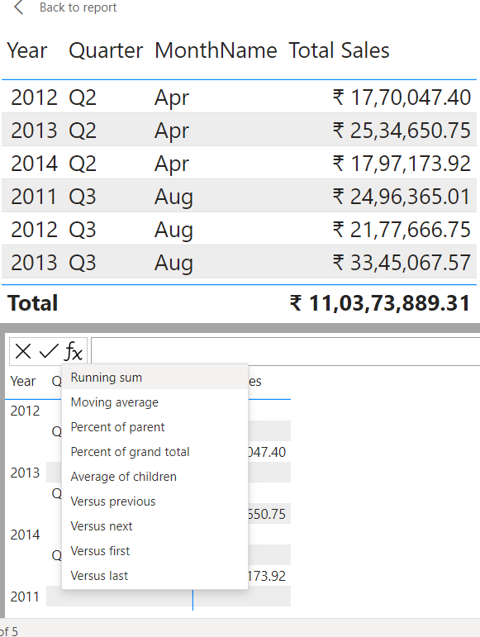
By default the visual calculations comes with certain pre-defined functions as shown below
Clicking on the FX button shows certain pre-defined calculations to be used, such as
Running sum
Moving average
Percent of parent
Percent of grand total
Average of children
Versus previous
Versus next
Versus first
Versus last

Slide 5
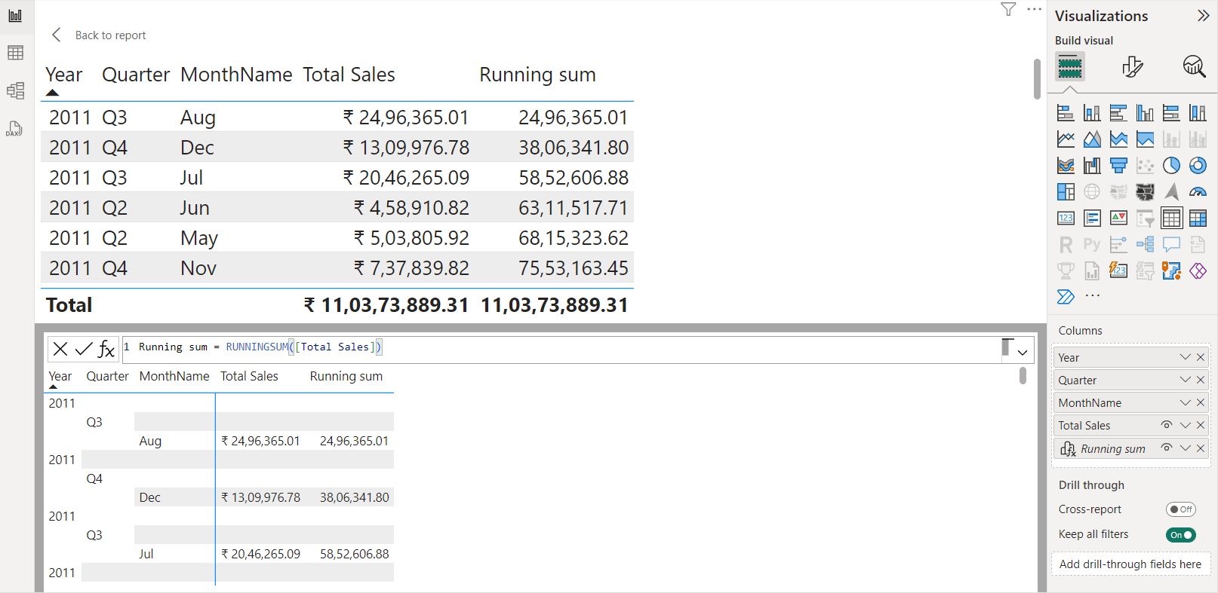
Dax made easy - Example
Ex – Calculation of running sum
Unlike writing complex DAX expression for running sum.
Steps -
Click on FX and select Running sum.
By just replacing Total sales measure in the ‘Field’. it automatically calculates and gives us the result column.
So easy.

Slide 6
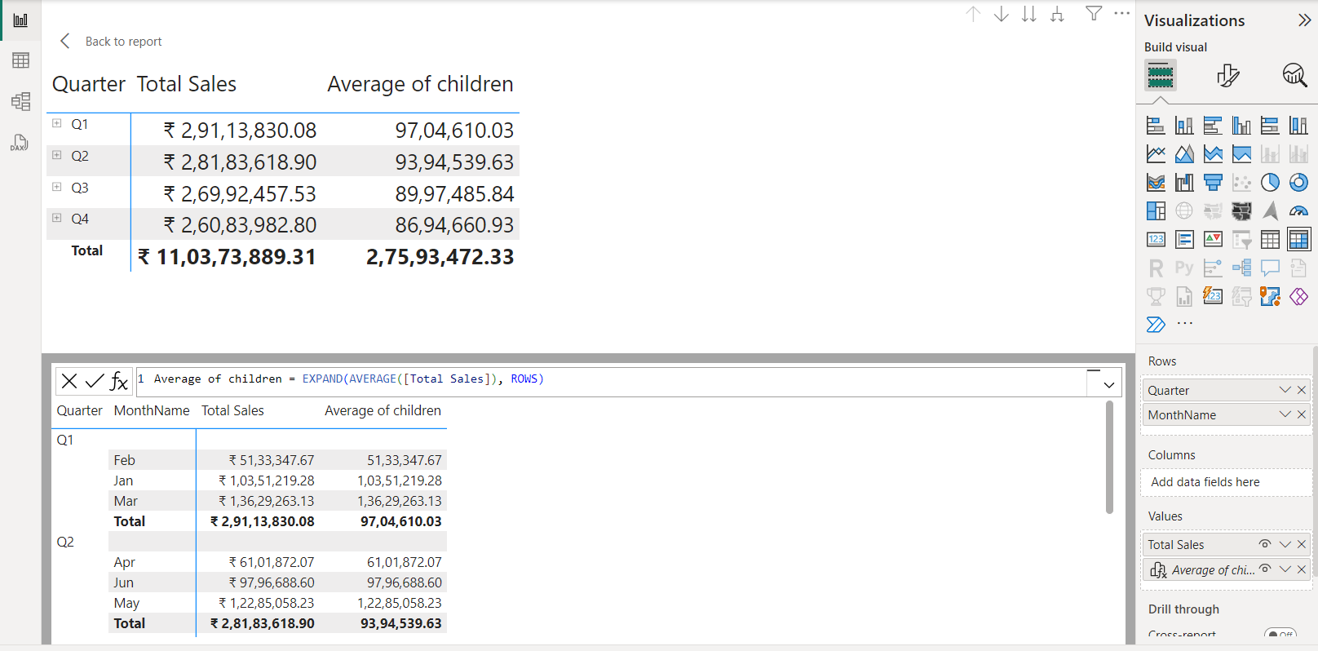
DAX made easy - Example
Ex – Calculating Average of children
Steps-
Click on FX option and select Average of children.
It automatically gives the DAX expression for the Average of children.
we just need to replace the ‘FIELD’ with the Total sales which we want to calculate.
After that give and Prompt the axis as rows to get the output Row wise.
Result- output we got is the average counting for each 3 months.
We’re using the other columns Quarters and months to see the proper result.

Slide 7
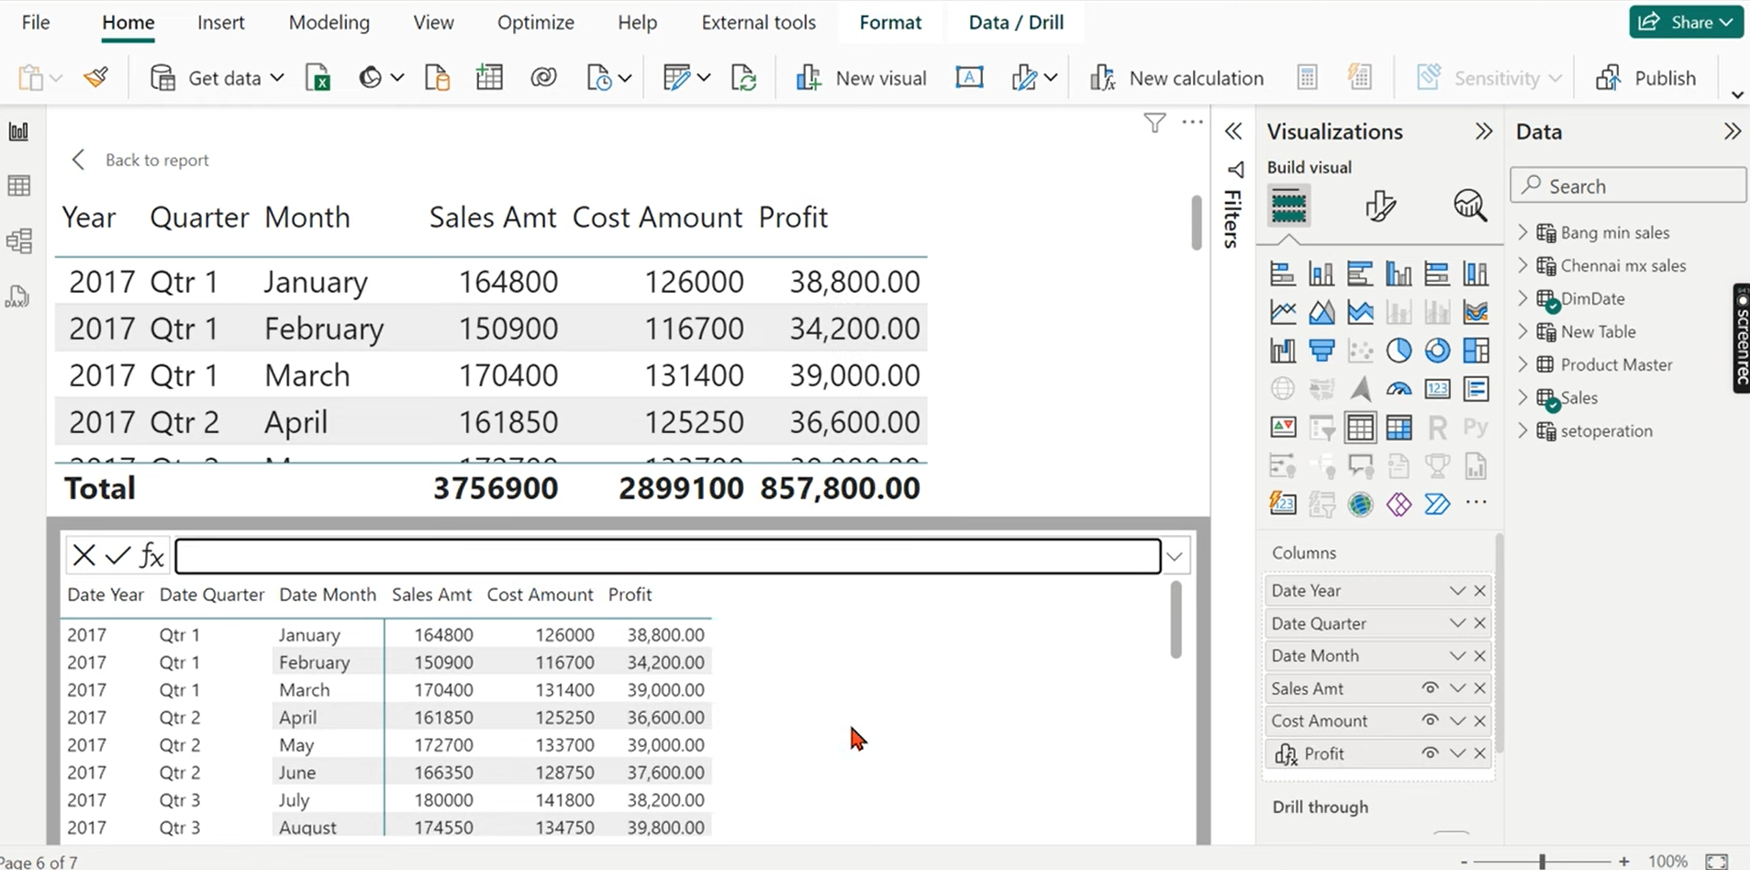
We can create measures inside the visual example
Ex – The Profit is calculated by writing the DAX as
Profit = [sales Amt] – [Cost Amt]
The symbol before the profit itself represents its different from other measures and columns.
Unlike the measures we create in the data field, it won’t be seen anywhere except in that visual.

Slide 8
DAX Query View
It is primarily used by advanced users and data professionals who need to perform detailed data analysis, create complex data models, and troubleshoot or optimize DAX queries.

Slide 9
What is it ?
It is essentially a user interface within Power BI Desktop where you can write, test, and run DAX queries. Unlike regular DAX expressions used in calculated columns or measures.
DAX queries are more similar to SQL queries in that they can return entire tables of data, rather than single values.

Slide 10
DAX queries are similar to SQL queries in that they can show you data you already have. DAX queries don't create items in the model or visuals in the report.
DAX queries have two main parts:
An EVALUATE statement, which is required. It specifies what and how data is returned in the query.
A DEFINE statement, which is optional. It allows you to define DAX formulas, such as a measure, to use in the query. Measures can be added to the model using CodeLens when used in DEFINE
Running Queries in DAX Query view is more handy and way more faster than the traditional way.
You can first run & check the queries and then can update in the Model or can be easily revert back as the same.
It’s easy and fast.

Slide 11
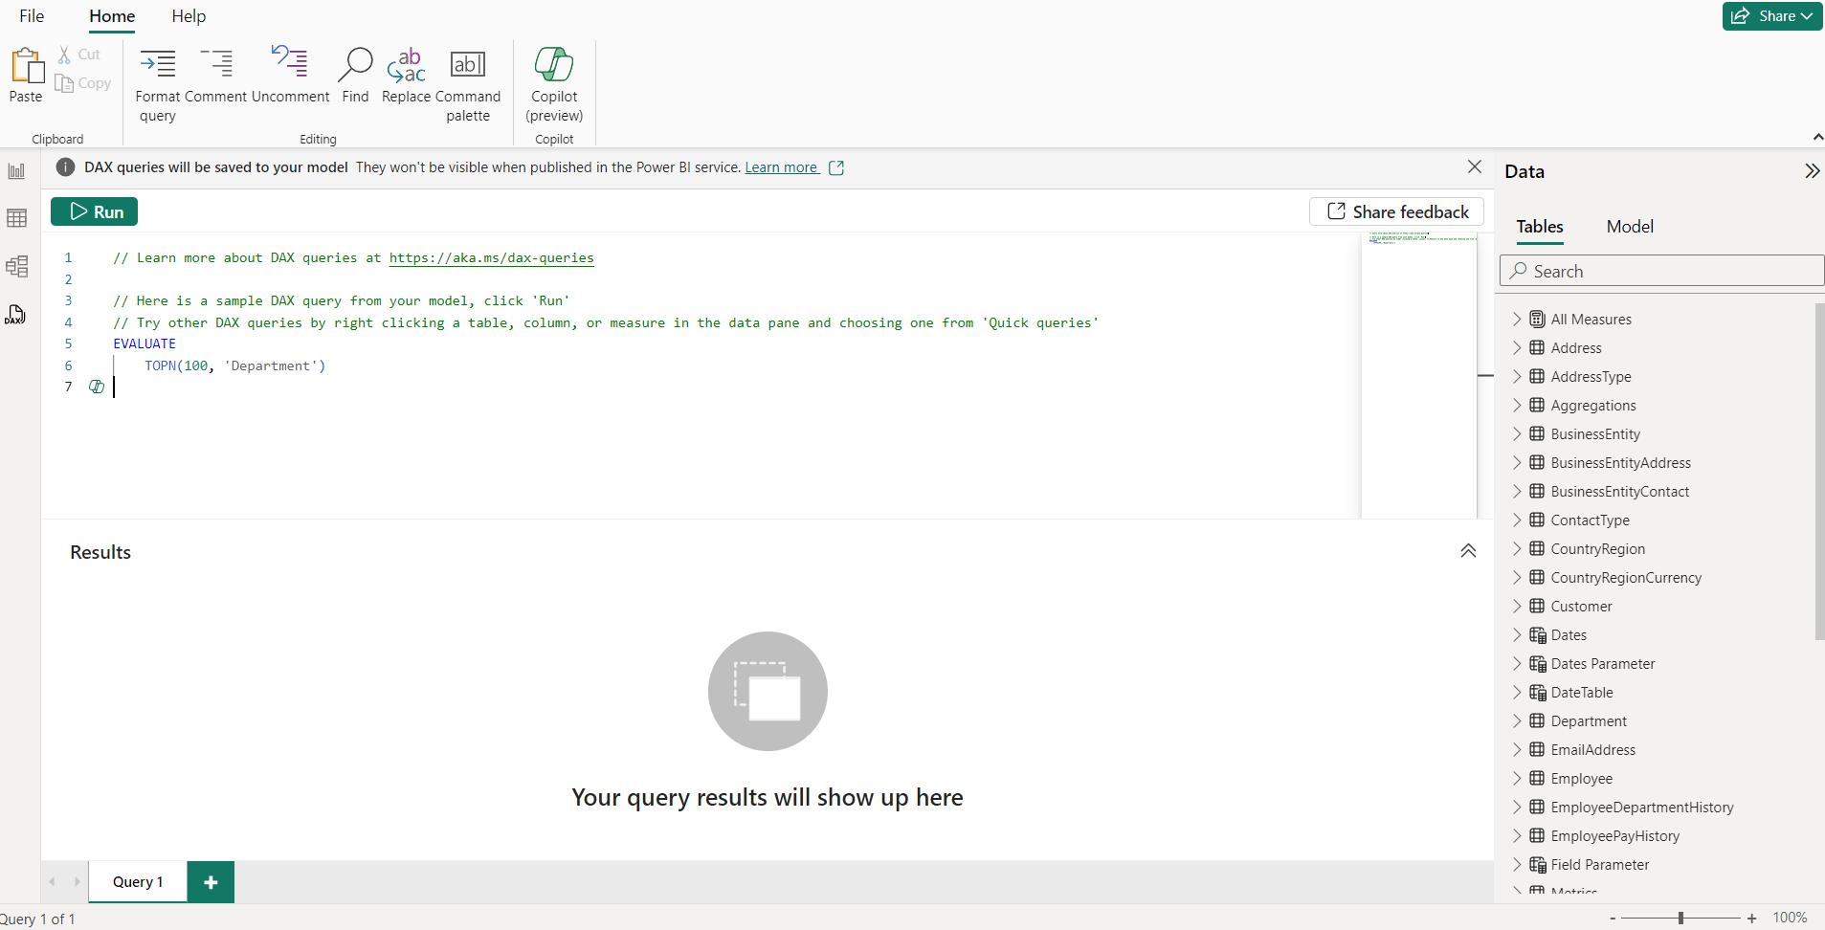
Interface –
To open the DAX Query view,
After opening PBI Desktop app
on left, a horizontal bar is with options to switch the views
By clicking on the last icon will open DAX Query view
And the interface will be like as shown.

Slide 12
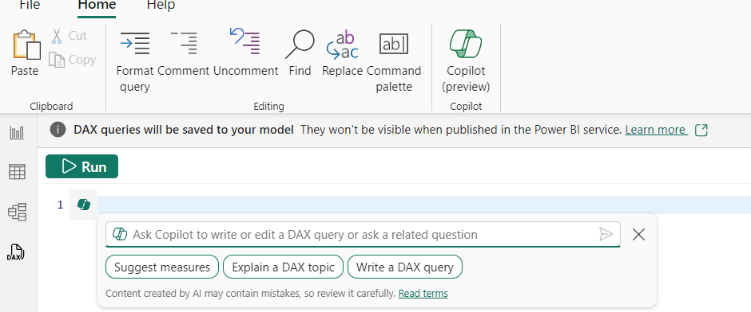
left side of the view
Here you can see the options palette like FILE & HOME and HELP.
Under the HOME you can see the options for Editing the query.
COPILOT is a program of AI which helps us by generating DAX queries as we prompt.
By clicking on that icon we can interact with COPILOT for helping us with DAX Queries.

Slide 13
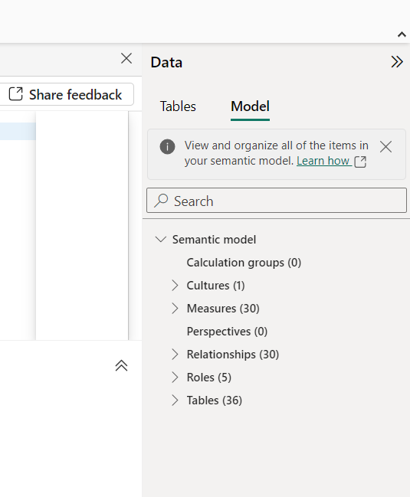
Right side of the view
In here we can see DATA palette with two options TABLES and MODEL
All the tables are present under the TABLES option same as in the report view.
Under the MODEL view there is a SEMANTIC MODEL of our data set is present with all the options at one place like
The total no measures in the dataset
The no of tables in the dataset
The total no of Relationships are present in the dataset.

Slide 14
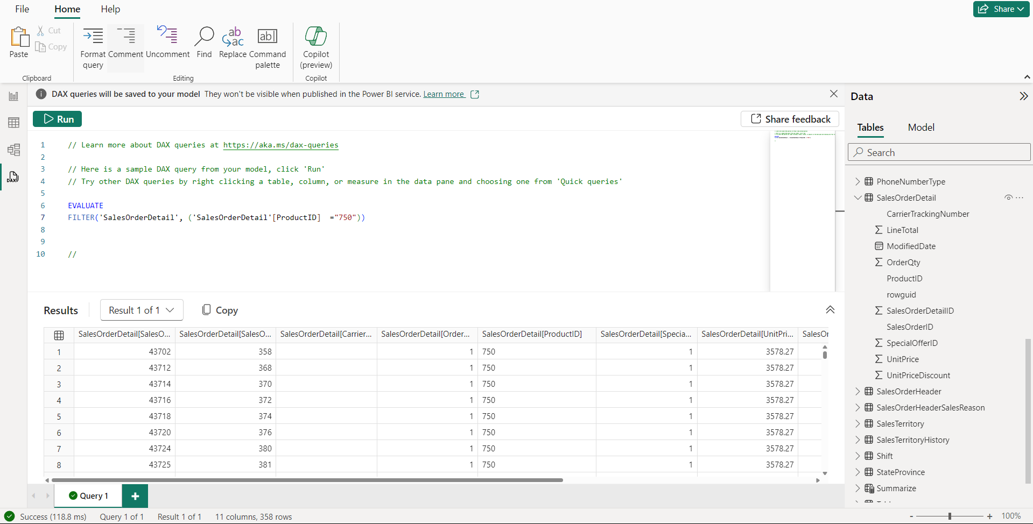
Example – filtering the data in a column using DAX query view
In this example I’ve filtered the data with the product ID which is ‘750’
Note – data type is TEXT
Syntax –
EVALUATE
FILTER('SalesOrderDetail', ('SalesOrderDetail'[ProductID] ="750"))
Result – The entire table is returned by filtering the product ID column data with the value ‘750’.

Slide 15
THE END

